Slide 1


Resource Management Group
SRI RAMAKRISHNA ENGINEERING COLLEGE
[Education Service: SNR Sons Charitable Trust]
[Autonomous Institution, Reaccredited by NAAC with ‘A+’ Grade]
[Approved by AICTE and Permanently Affiliated to Anna University, Chennai]
[ISO 9001:2015 certified, All eligible programmes Accredited by NBA]
VATTAMALAIPALAYAM, N.G.G.O Colony P.O, Coimbatore - 641 022
DEPARTMENT OF COMPUTER SCIENCE & ENGINEERING
INTERN PROJECT
ASPIRE SYSTEMS
TEAM MEMBERS
MONISHA S (1901116)
KISHORE V V (1901107)
ROHITH A (1901203)
PROJECT GUIDE
Mrs. P.Sugantha Priyadharshini(A.P)

Slide 2
AGENDA
Introduction
Problem Definition
Modules
Hardware and Software Requirements
Flow Diagram
Time slot for project represented in Gantt chart

Slide 3
INTRODUCTION
It basically includes the requirements for managing the personal data, controlling authentication and authorization mechanism, and evaluating of employees’ performance. After creating the new RMG we have to accomplish data migration from their existing system to our new one.
More specifically, our RMG controls and manages the personal database such that any user with different role types as manager, employee and human resource will be able to manipulate their personal data.
In addition to manipulating the personal data, our RMG will provide authentication and authorization mechanism. Every user with any role type can be able to login to the system with his/her username and password.

Slide 4
PROBLEM DEFINITION
Nowadays, companies try to enhance their management and have a better control over their employees. In order to fulfill these requirements in a more efficient way they need software called Resource Management System.
Resource Management System is software which satisfies the needs of the Human Resources Department of a company to manage employee personal data (citizen identity number, name, surname, birth- date, birthplace, educational information etc.), annual leaves, payroll, trainings, skills, performance evaluation and so on. Our Resource Management System will meet the needs for managing the personal data, system authentication and authorization of an employee.

Slide 5
CONT.
Our RMG project is being developed for companies who want to control and manage their employee’s data in a more appropriate and neat way. With the help of our project they will have better software to manage their personal data, control mechanism to authorize and authenticate for the employees’ entry.

Slide 6
MODULES
Register and Login
Manager
HR
Employees

Slide 7
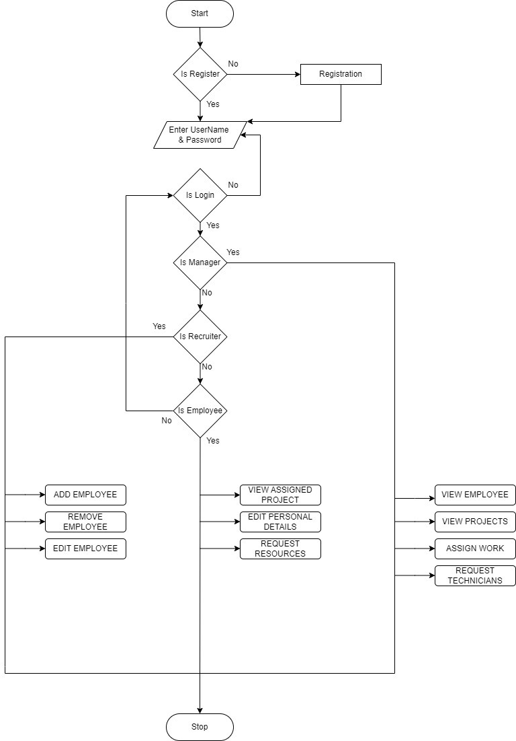
FLOW DIAGRAM

Slide 8
HARDWARE AND SOFTWARE REQUIREMENTS
SQL Server
Visual Studio Code
Dotnet core

Slide 9
IMPLEMENTATION RESULTS

Slide 10
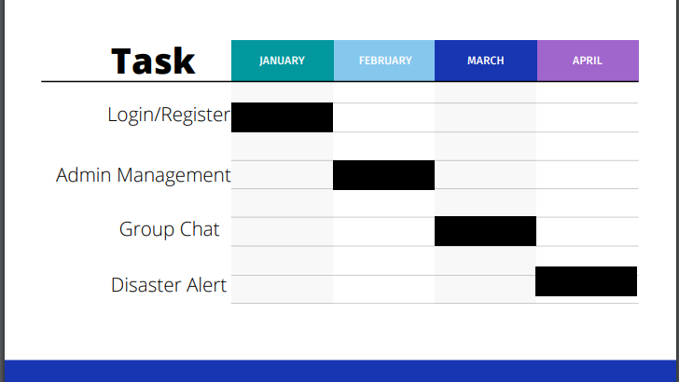
TIME SLOT FOR PROJECT REPRESENTED IN GANTT CHART

Slide 11

THANK YOU

